Slide 1

Distinguished Lecture (2018-2019)
Generative Adversarial Networks for Speech Technology
Prof. Hemant A. Patil
DA-IICT Gandhinagar, India.
On behalf of Speech Group @DA-IICT
Email: hemant.patil@samsung.com, hemant_patil@daiict.ac.in
APSIPA Winter School， Lanzhou
November 17, 2019

Slide 2
Introduction to APSIPA and APSIPA DL
APSIPA Mission: To promote broad spectrum of research and education activities in signal and information processing in Asia Pacific APSIPA Conferences: ASPIPA Annual Summit and Conference APSIPA Publications: Transactions on Signal and Information Processing in partnership with Cambridge Journals since 2012; APSIPA Newsletters APSIPA Social Network: To link members together and to disseminate valuable information more effectively APSIPA Distinguished Lectures: An APSIPA educational initiative to reach out to the community

Slide 3
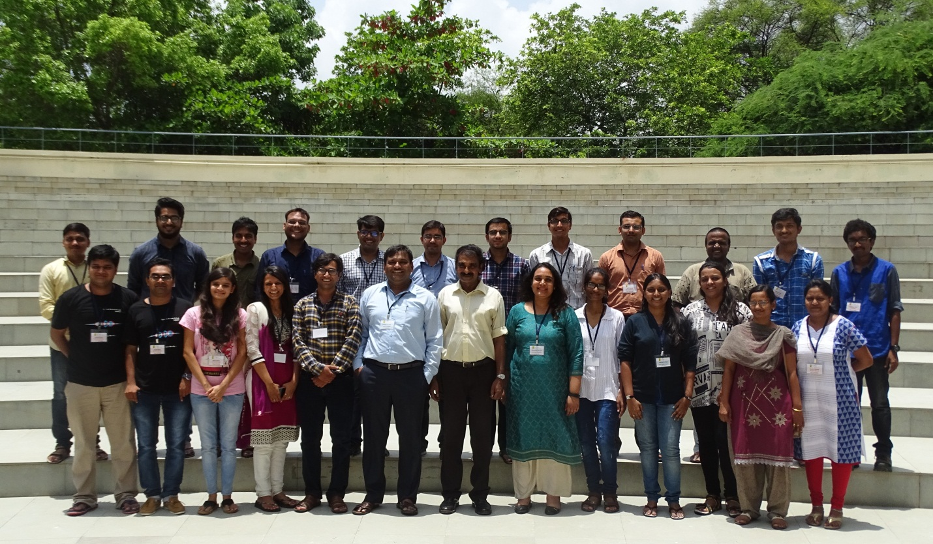
Speech Research Group

Slide 4
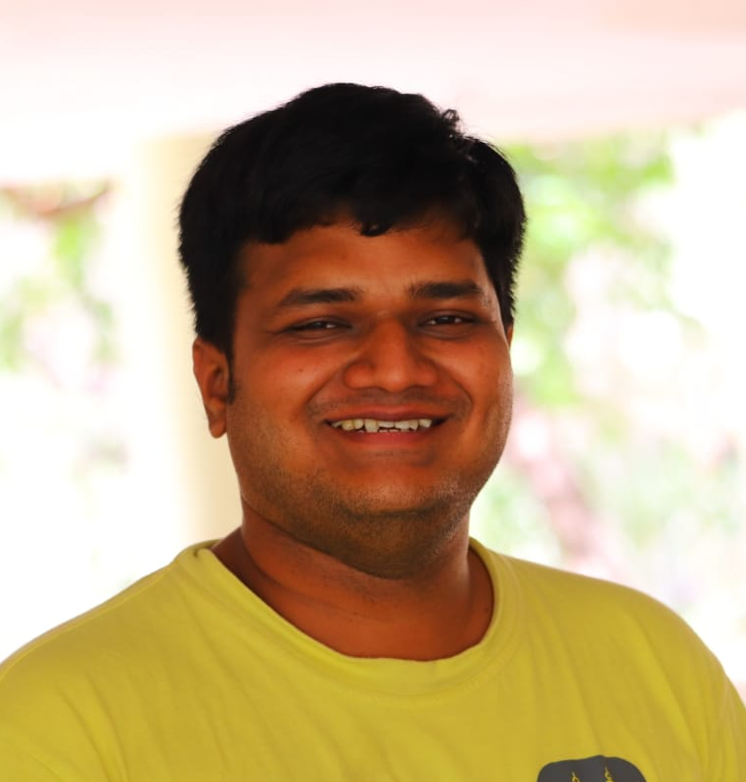

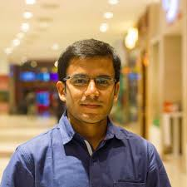

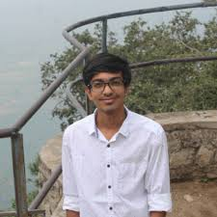
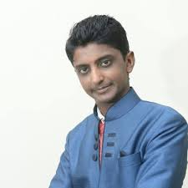
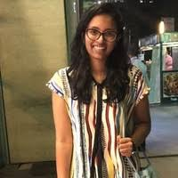
GAN Team @ Speech Research Lab, DA-IICT
Nirmesh J. Shah
Intern at Samsung R&D Institute, Bangalore
Meet H Soni
TCS Innovation Lab, Mumbai
Neil Shah
Mercer Mettl, Noida
Mihir Parmar
Got admission to M.S., Arizona State University, USA
Saavan Doshi
DA-IICT, Gandhinagar
Maitreya Patel
DA-IICT, Gandhinagar
Jui Shah
DA-IICT, Gandhinagar

Slide 5


Slide 6
Presentation Overview
Supervised vs. Unsupervised Learning
Generative Models
Generative Adversarial Networks (GANs)
Applications
Image Processing
Computer Vision
Speech Technology
Training of GANs
Open Research Problems

Slide 7
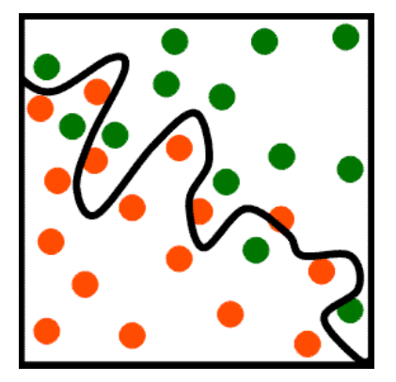

Supervised Learning
Data $(X,Y)$ are given, where $X$ is Data and $Y$is Label
Task is to find mapping $X→Y$
Examples:
Classification
Regression
Object Detection
Decision
Boundary
2-D Feature vector
Source: Bishop, Christopher M., ”Pattern recognition and machine learning”, First Edition, Springer, 2006.

Slide 8
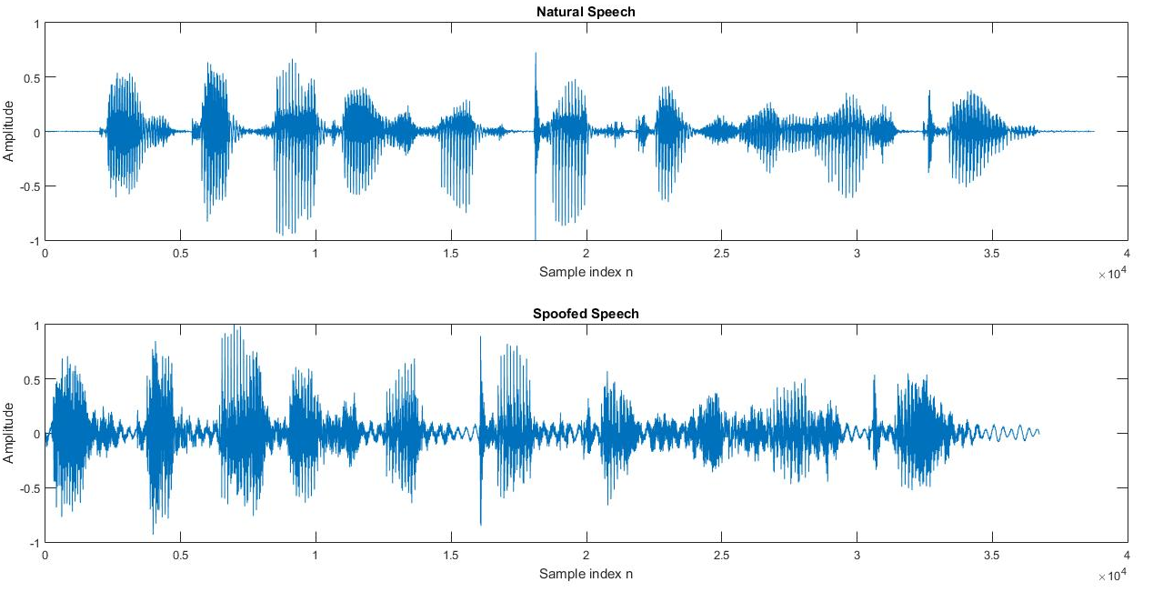

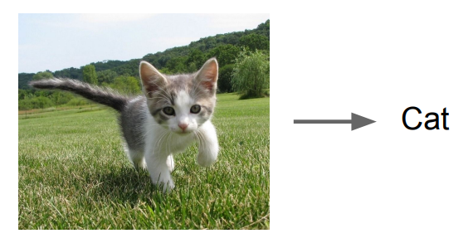
Supervised Learning
Classification Task
Image Classification
Spoof Speech Classification
Source
Bishop M. Christopher, ”Pattern recognition and machine learning”, First Edition, Springer, 2006.
Hemant A. Patil, Madhu R. Kamble, Haizhou Li, “Tutorial On: Spoofing Attack of Speaker Recognition”, Asia - Pacific Signal and Information Processing Association Annual Summit and Conference 2017 (APSIPA ASC 2017 ) Kuala Lumpur, Malaysia

Slide 9
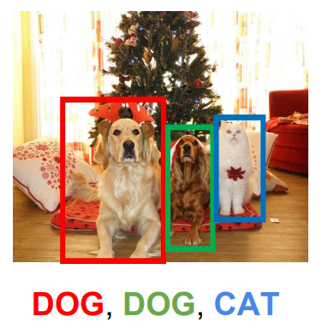
Supervised Learning
Object Detection
Source
Friedland, G., Vinyals, O., Huang, Y., & Muller, C. (2009). Prosodic and other long-term features for speaker diarization. IEEE Transactions on Audio, Speech, and Language Processing, vol. 17, no. 5, pp. 985-993.

Slide 10


Supervised Learning
Voice Conversion
We speak the same sentences
We speak the same sentences
Mapping function estimation
Hi, I am from
SRI, Bangalore
Hi, I am from
SRI, Bangalore
Conversion
?
Source
Hemant A. Patil, Hideki Kawahara, “Voice Conversion: Challenges and Opportunities”, Asia-Pacific Signal and Information Processing Association Annual Summit and Conference (APSIPA ASC ), Hawaii, USA, 2018.

Slide 11
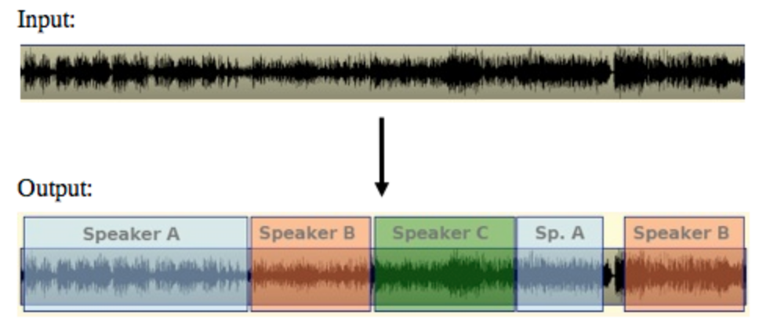

Unsupervised Learning
Data: $X$ only; No labels
Task is to learn underlying
hidden structure of data
Examples:
Clustering ->K-means
Dimensionality Reduction
Feature Learning
Density Estimation
Speaker Diarization: Who Spoke When ?
Source
Bishop M. Christopher, ”Pattern recognition and machine learning”, First Edition, Springer, 2006.

Slide 12
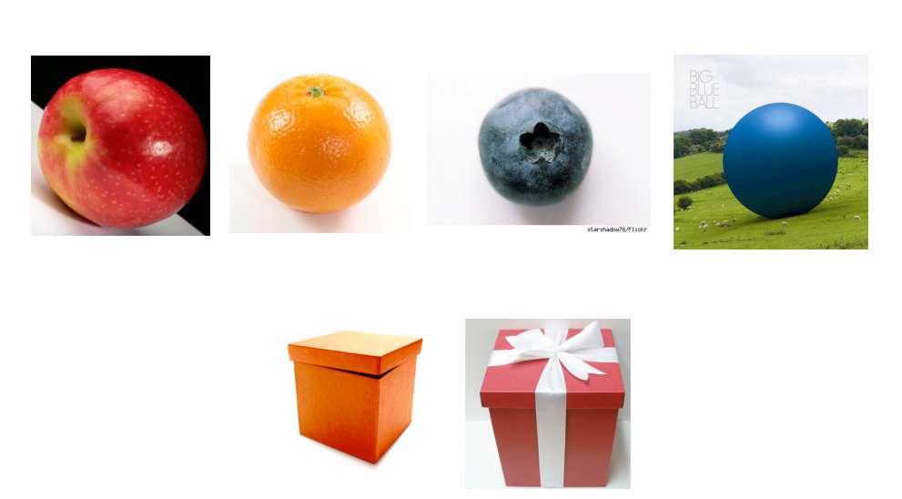
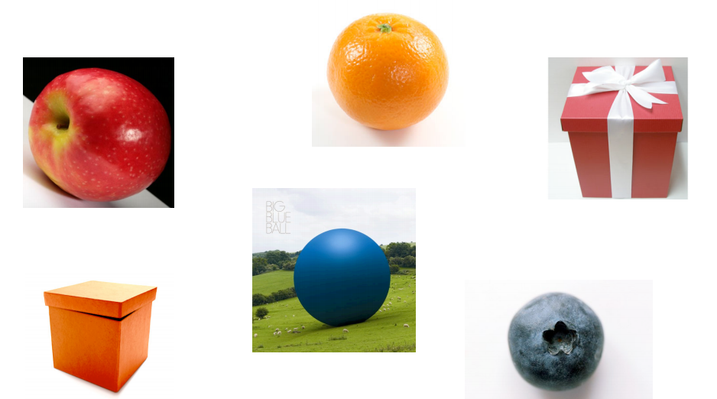
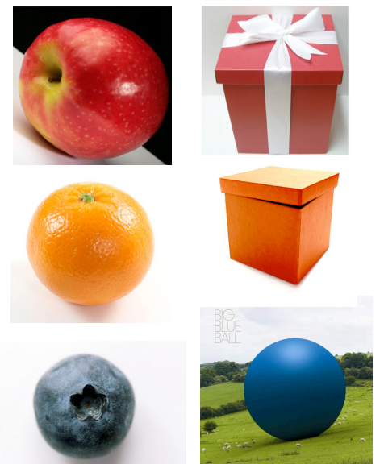
Unsupervised Learning
Attribute: Shape
Class 1
Class 2
Attribute: Color
Class 1
Class 2
Class 3
Source
Bishop M. Christopher, ”Pattern recognition and machine learning”, First Edition, Springer, 2006.

Slide 13
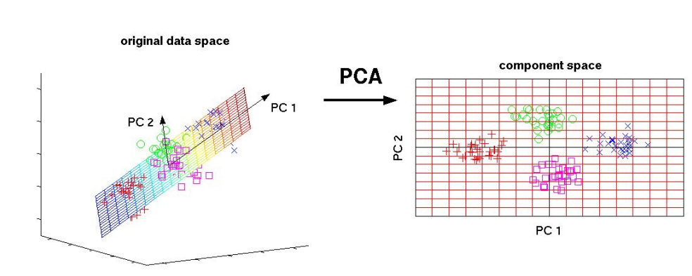
Unsupervised Learning (Contd.)
Principal Component Analysis (PCA): Dimensionality Reduction
2-D
3-D
Source
H. Abdi, & Williams, L. J., “Principal Component Analysis”, Wiley Interdisciplinary Reviews: Computational Statistics, 2(4), 433-459.

Slide 14
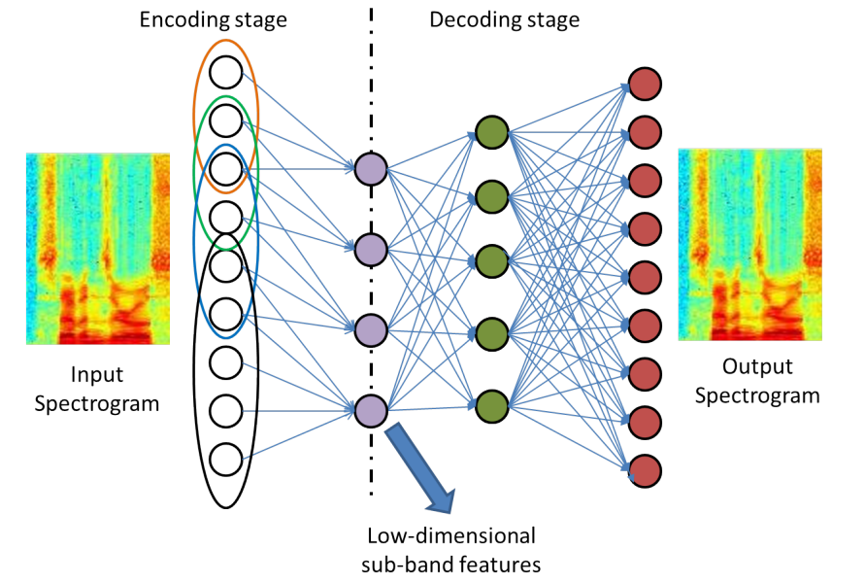
Unsupervised Learning (Contd.)
Feature Learning
Source
Meet H. Soni, Tanvina B. Patel, and Hemant A. Patil. "Novel Subband Autoencoder Features for Detection of Spoofed Speech" In INTERSPEECH, San Francisco, USA, 2016, pp. 1820-1824.

Slide 15
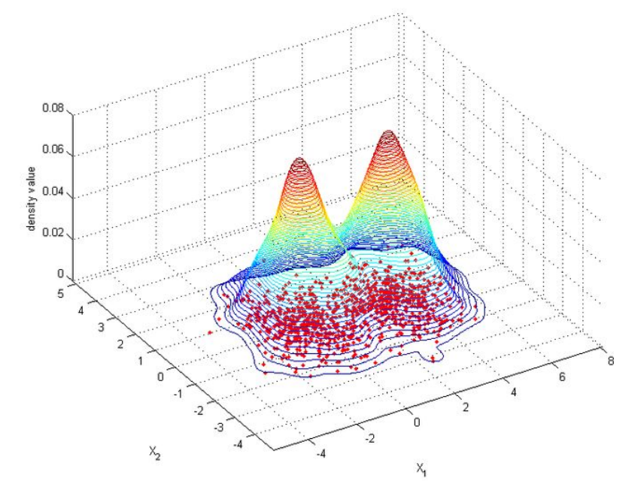
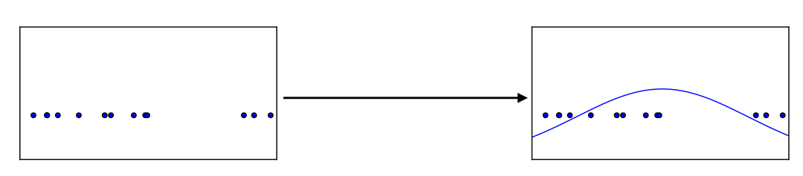
Unsupervised Learning
Density Estimation: Central Problem in Signal Processing and Statistics !
Density Estimation for 1-D Data
Mixture of Two Gaussians !
Density Estimation for 2-D Data
Source:
Ian J. Goodfellow, Pouget-Abadie, Mehdi Mirza, Bing Xu, David Warde-Farley, Sherjil Ozair, Aaron Courville, and Yoshua Bengio. "Generative Adversarial nets." In Advances in Neural Information Processing Systems (NIPS), pp. 2672-2680, 2014.

Slide 16
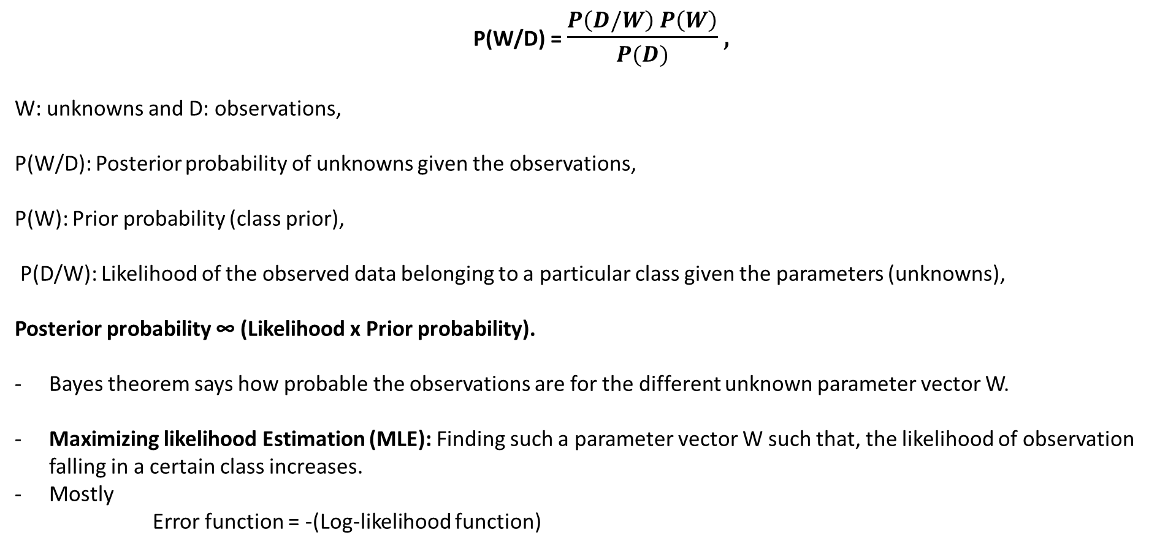
Bayes theorem
P(W/D) = $\frac{P\left(D/W\right) P\left(W\right)}{P(D)},$
W: unknowns and D: observations,
P(W/D): Posterior probability of unknowns given the observations,
P(W): Prior probability (class prior),
P(D/W): Likelihood of the observed data belonging to a particular class given the parameters (unknowns),
Posterior probability ∞ (Likelihood x Prior probability).
Bayes theorem says how probable the observations are for the different unknown parameter vector W.
Maximizing likelihood Estimation (MLE):Finding such a parameter vector W such that, the likelihood of observation falling in a certain class increases.
Mostly
Error function = -(Log-likelihood function)

Slide 17
Issues with MLE ?
Why log-likelihood ?
Log being monotonic function -> Optimization of MLE decision won’t affect
Statistical independence -> multiplication of prob. -> underflow of numbers
Simplifies algebraic expression for derivation of likelihood
Exact MLE is intractable !

Slide 18

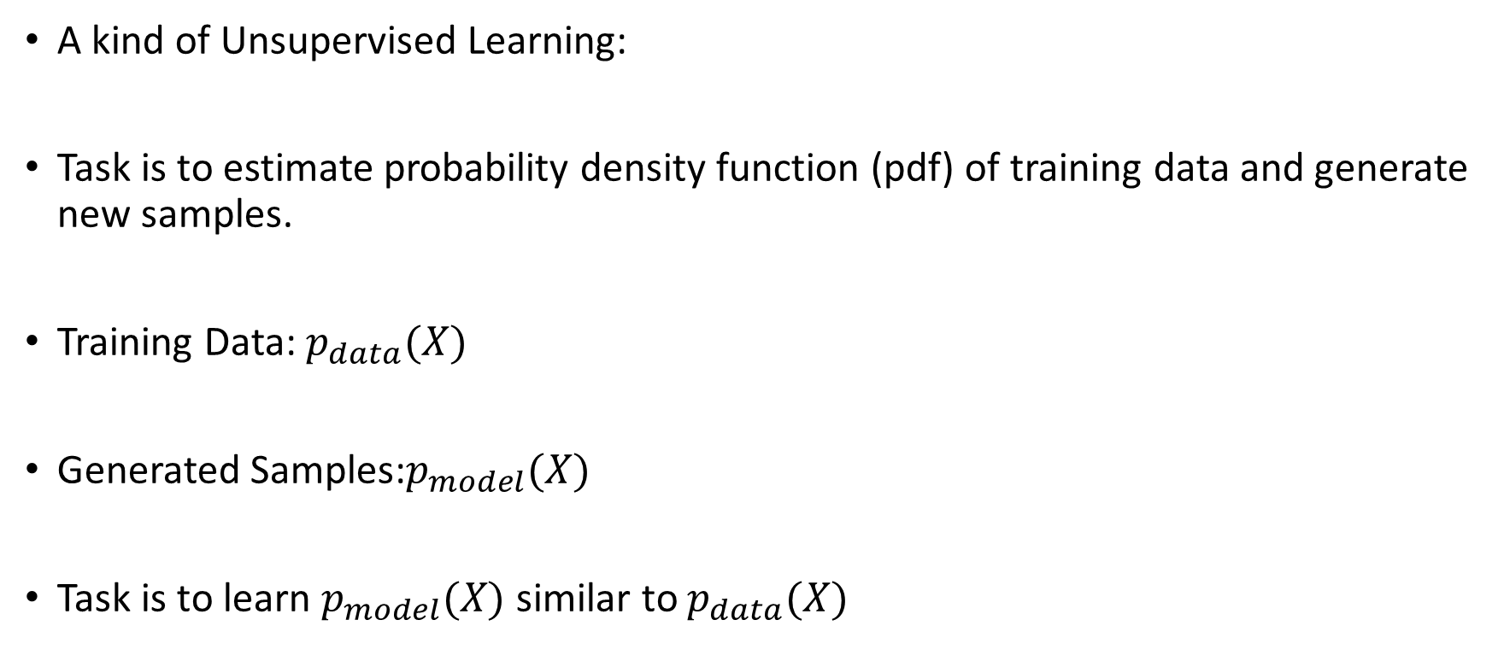
Generative Models
A kind of Unsupervised Learning:
Task is to estimate probability density function (pdf) of training data and generate new samples.
Training Data: $p_{data}(X)$
Generated Samples:$p_{model}(X)$
Task is to learn $p_{model}(X)$ similar to $p_{data}(X)$
Training Data
Generated Data
Source
Ian J. Goodfellow, Pouget-Abadie, Mehdi Mirza, Bing Xu, David Warde-Farley, Sherjil Ozair, Aaron Courville, and Yoshua Bengio. "Generative Adversarial nets." In Advances in Neural Information Processing Systems (NIPS), pp. 2672-2680. 2014.

Slide 19
Generative Adversarial Networks (GANs)
Is there a Neural network apart from Deep Neural Network (DNN) that could learn the mapping function?
Ans:
A DNN is mostly used to predict an enhanced spectrum from the noisy spectrum.
Currently, all such approaches use MLE-based optimization (such as, Minimum Mean Square Error (MMSE) objective function assumes the output variables to be Gaussian) which may not be valid for the given data.
This assumptions may prevent the network to learn perceptually optimal parameters for several speech technology applications.
For T-F masking-based approaches, the difference between the performance of the clean speech and the enhanced speech indicates the need of better objective function.
GANs provides one such alternative of MLE-based optimization.

Slide 20
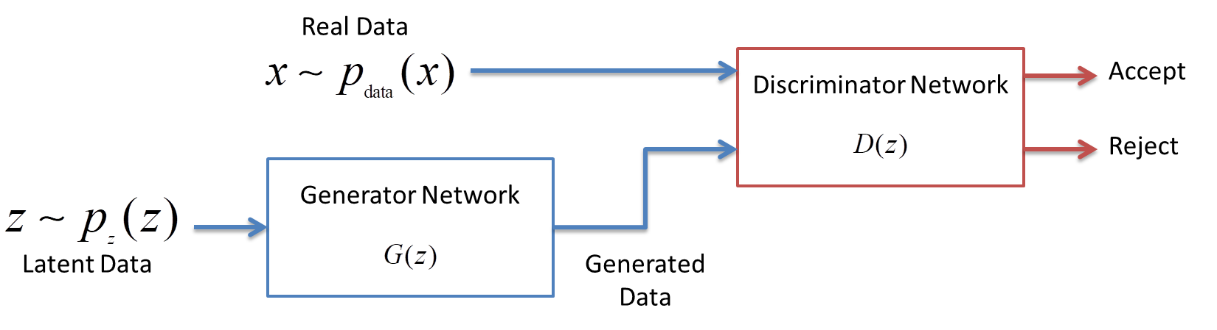
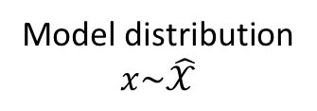
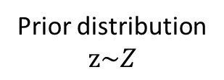
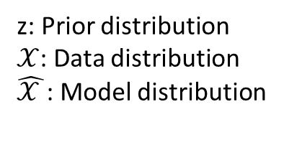
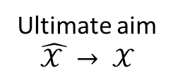
Generative Adversarial Networks (GANs)
- Generative model: Produces samples that resemble the samples generated from the data.
Learns Mapping
z: Prior distribution
$𝒳$: Data distribution
$\hat{𝒳 }$: Model distribution
Ultimate aim
$$\hat{𝒳 }→ 𝒳$$
Prior distribution
$$z\sim Z$$
Model distribution
$$x\sim \hat{𝒳}$$
GAN
Fig.: Generative Adversarial Network Schematic Representations.
Source
Ian J. Goodfellow, Pouget-Abadie, Mehdi Mirza, Bing Xu, David Warde-Farley, Sherjil Ozair, Aaron Courville, and Yoshua Bengio. "Generative Adversarial nets." In Advances in Neural Information Processing Systems, pp. 2672-2680. 2014

Slide 21



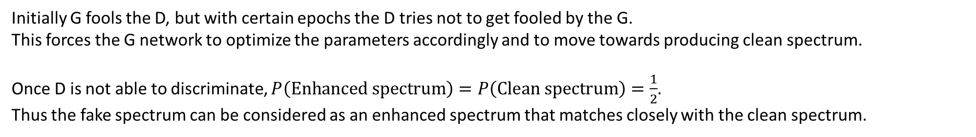
Initially
Adversarial training
Easily identifies the generator produced spectrum as fake
Noisy spectrum
G
Fake spectrum
D
Clean spectrum
After few epochs
Gets confused between generator produced spectrum and clean spectrum
Adversarial training
Noisy spectrum
G
Enhanced
spectrum
D
Clean spectrum
Initially G fools the D, but with certain epochs the D tries not to get fooled by the G.
This forces the G network to optimize the parameters accordingly and to move towards producing clean spectrum.
Once D is not able to discriminate, $P\left(Enhanced spectrum\right)=P\left(Clean spectrum\right)=\frac{1}{2}$.
Thus the fake spectrum can be considered as an enhanced spectrum that matches closely with the clean spectrum.

Slide 22
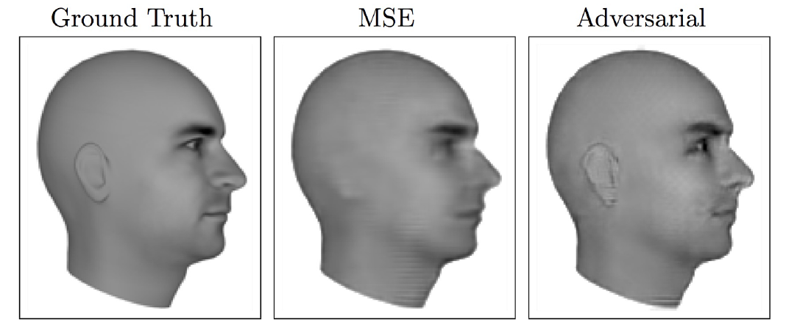
Applications of GANs: Video Sequence Prediction
Figure: A model is trained to predict the next frame in a video sequence.
Source
Ian J. Goodfellow, Pouget-Abadie, Mehdi Mirza, Bing Xu, David Warde-Farley, Sherjil Ozair, Aaron Courville, and Yoshua Bengio. "Generative Adversarial nets." In Advances in Neural Information Processing Systems, pp. 2672-2680, 2014.
Lotter, W., Kreiman, G., and Cox, D. , “Unsupervised learning of visual structure using predictive generative networks” arXiv preprint arXiv:1511.06380 .

Slide 23
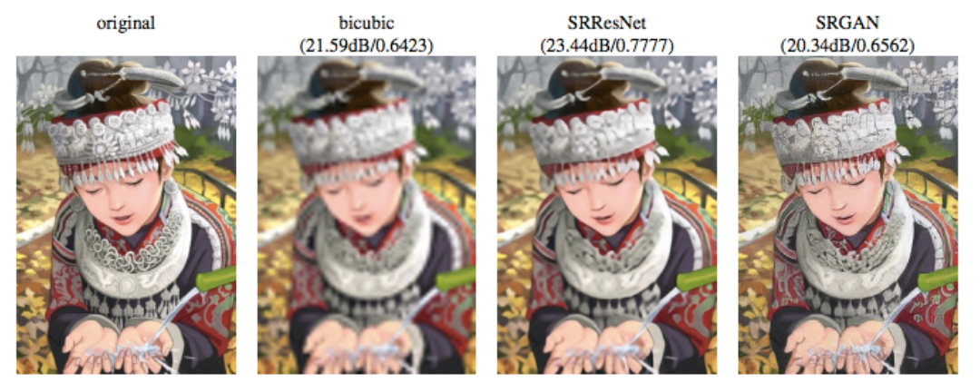
Applications (contd.): Image Super resolution
Figure: An Example of Single Image Super resolution.
Source
Ian J. Goodfellow, “Tutorial: Generative adversarial networks”, In Advances in Neural Information Processing Systems, 2016
Ledig, C., Theis, L., Huszar, F., Caballero, J., Aitken, A. P., Tejani, A., Totz, J., Wang, Z., and Shi, W., “Photo-realistic single image super-resolution using a generative adversarial network”, CoRR, abs/1609.04802.

Slide 24
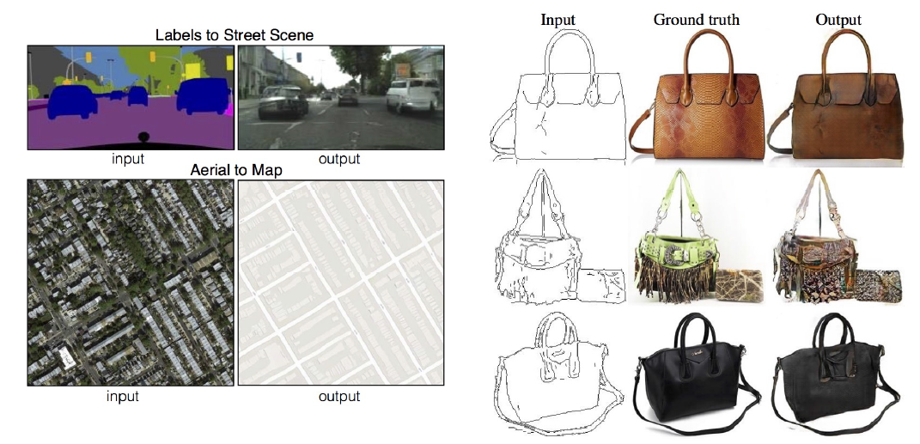
Applications (contd.): Image-to-Image Translation
Figure: Examples of Image-to-Image Translation.
Source
Ian J. Goodfellow, “Tutorial: Generative adversarial networks”, In Advances in Neural Information Processing Systems, 2016
Isola, P., Zhu, J.-Y., Zhou, T., and Efros, A., “A. (2016). Image-to-image translation with conditional adversarial networks,” arXiv preprint arXiv:1611.07004 .

Slide 25
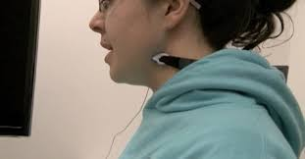

Applications (contd.): NAM -> Whisper
Non-audible Murmur-to-Whisper Speech Conversion
NAM Signal | Target Whisper Speech | Converted Whisper Speech
Figure: Recording of Body Conducted Whispered Speech using NAM microphone .
Source
Neil Shah, Nirmesh J. Shah, and Hemant A. Patil, "Effectiveness of Generative Adversarial Network for Non-Audible Murmur-to-Whisper Speech Conversion", in INTERSPEECH, Hyderabad, India, 2018, pp. 3157-3161

Slide 26
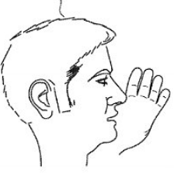
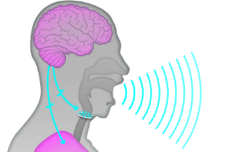
Applications (contd.): Whisper -> Normal
Whispered Speech-To-Normal Speech (WHSP2SPCH) Conversion
WHSP2SPCH
Whispered Speech | Converted Normal Speech
Source
Nirmesh J. Shah, Mihir Parmar, Neil Shah and Hemant A. Patil, "Novel MMSE DiscoGAN for Cross-Domain Whisper-to-Speech Conversion", in Machine Learning in Speech and Language Processing (MLSLP) Workshop, Google Office, Hyderabad, September 7, 2018, pp. 1-3.

Slide 27
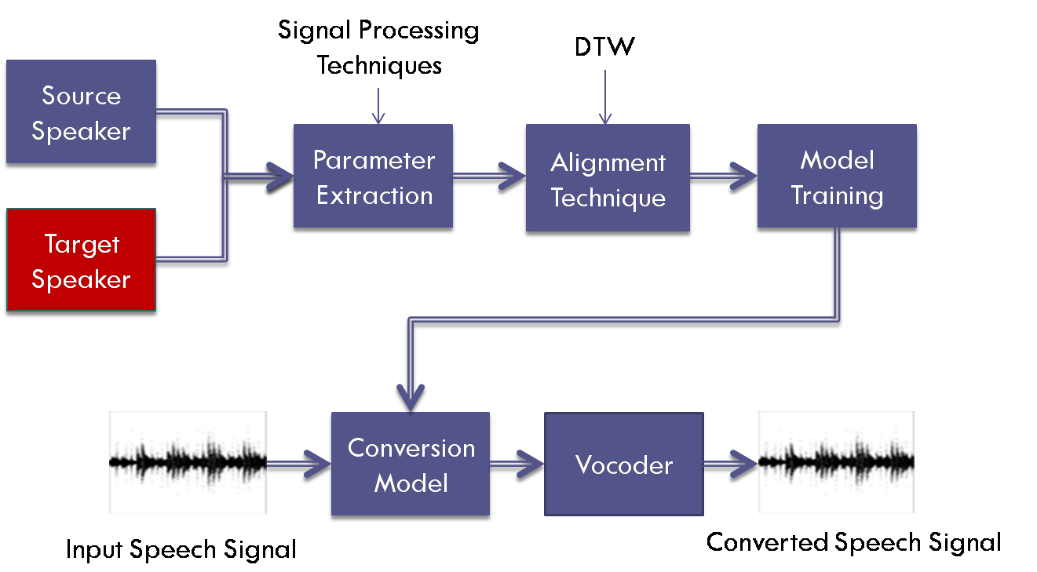

Applications (contd.): Voice Conversion
Source Speaker | Converted Voice | Target Speaker
Figure: General System Architecture of Voice Conversion.
Source:
Nirmesh J. Shah, Maulik C Madhavi, and Hemant A. Patil, “Unsupervised vocal tract length warped posterior features for non-parallel voice conversion,” in INTERSPEECH, Hyderabad, India, 2018, pp. 1968–1972.

Slide 28
Applications (contd.): Speech Enhancement
Oracle mask
DNN: Better than
v-GAN, not better
than
MMSE-GAN
v-GAN:
Very poor mask
prediction by v-GAN
Figure: (a) Oracle mask, Gammatone spectrum of (b) clean speech, (c) noisy speech. Predicted mask using (d) DNN, (e) GAN, (f) MMSE-GAN. Gammatone spectrum of reconstructed speech using (g) DNN, (h) GAN, (i) MMSE-GAN.
Source:
Meet H. Soni, Neil Shah, and Hemant A. Patil, ”Time-Frequency masking-based speech enhancement using Generative Adversarial Network”, in IEEE International Conference on Acoustics, Speech, and Signal Processing (ICASSP), Calgary, Alberta, Canada, 2018, pp. 5039–5043.

Slide 29
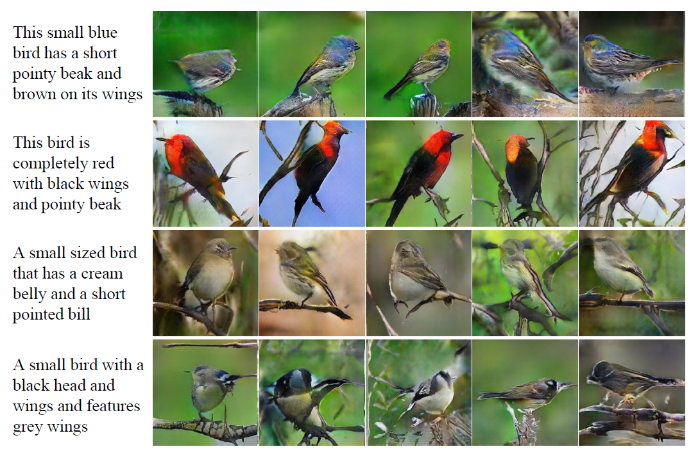
Applications (contd.): Text-to-Image Synthesis
Figure: Examples of Text-to-Image Synthesis.
Source
Ian J. Goodfellow, “Tutorial: Generative adversarial networks”, In Advances in Neural Information Processing Systems, 2016
Zhang, H., Xu, T., Li, H., Zhang, S., Huang, X., Wang, X., and Metaxas, D., “Stackgan: Text to photo-realistic image synthesis with stacked generative adversarial networks,” arXiv preprint arXiv:1612.03242

Slide 30
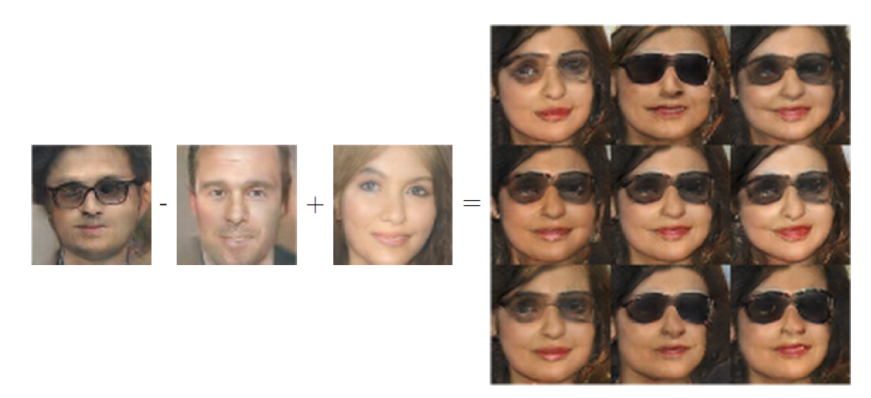
Applications (contd.): Learning Distributed Representation
Figure: GANs can learn a distributed representation that disentangles the concept of gender from the concept of wearing glasses.
Source
Ian J. Goodfellow, “Tutorial: Generative adversarial networks”, In Advances in Neural Information Processing Systems, 2016
Radford, A., Metz, L., and Chintala, S., “Unsupervised representation learning with deep convolutional generative adversarial networks”, arXiv preprint arXiv:1511.06434 .

Slide 31
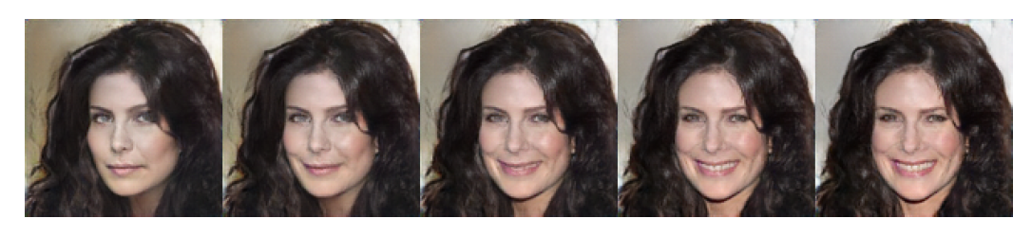
Applications (contd.): Applying Smile Vector
Figure: Example of Applying Smile Vector with an ALI Model.
Another Application: Conversion of old to young looking face.
Source
Antonia Creswell, Tom White, Vincent Dumoulin, Kai Arulkumaran, Biswa Sengupta, and Anil A. Bharath. "Generative adversarial networks: An overview." IEEE Signal Processing Magazine, vol. 35, no. 1, Jan. 2018, pp: 53-65.
V. Dumoulin, I. Belghazi, B. Poole, O. Mastropietro, A. Lamb, M. Arjovsky, and A. Courville, “Adversarially learned inference,” in Proceedings of the International Conference on Learning Representations, 2017.
Ian J. Goodfellow, “Tutorial: Generative adversarial networks”, In Advances in Neural Information Processing Systems, 2016

Slide 32
Generative Adversarial Networks (GANs)
Figure: Generative Adversarial Network Schematic Representations.
Objective Function:
$$V\left(G,D\right)=𝔼_{x\sim p_{data}\left(x\right)}[\log\left(D\left(x\right)\right)] +𝔼_{z\sim p_{z}\left(z\right)}[\log{(1−D(G(z)))}]$$
Source
Ian J. Goodfellow, Pouget-Abadie, Mehdi Mirza, Bing Xu, David Warde-Farley, Sherjil Ozair, Aaron Courville, and Yoshua Bengio. "Generative Adversarial nets." In Advances in Neural Information Processing Systems, pp. 2672-2680. 2014

Slide 33

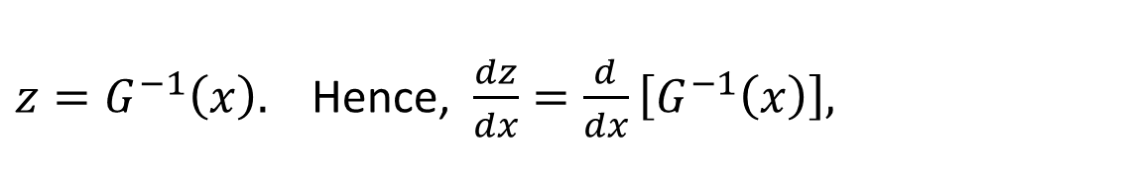
Objective Function of GANs
Proposition 1: For $G$ fixed, the optimal discriminator is, ${D^{∗}}_{G}\left(x\right)=\frac{p_{data}(x)}{p_{data}\left(x\right)+p_{g}(x)}$
Proof: Objective Function of GANs is
$$V\left(G,D\right)=𝔼_{x\sim p_{data}\left(x\right)}[\log\left(D\left(x\right)\right)] +𝔼_{z\sim p_{z}\left(z\right)}[\log{(1−D(G(z)))}]$$
$$V\left(G,D\right)=\int_{x}{p_{data}\left(x\right)\log{(D(x))}dx}+\int_{z}{p_{z}\left(z\right)\log{(1−D(G(z)))}dz}$$
$z=G^{−1}\left(x\right).$ Hence, $\frac{dz}{dx}=\frac{d}{dx}\left[G^{−1}\left(x\right)\right],$
Let us take
i.e.,
$$dz=G^{−1}′\left(x\right)dx$$
$$∴V\left(G,D\right)=\int_{x}{p_{data}\left(x\right)\log{(D(x))}dx}+ \int_{x}{p_{z}\left(G^{−1}(x)\right)\log{(1−D(x))}G^{−1}′\left(x\right)dx }$$

Slide 34
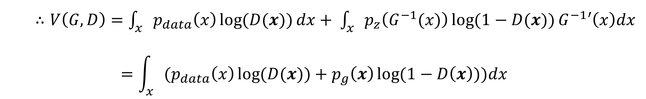
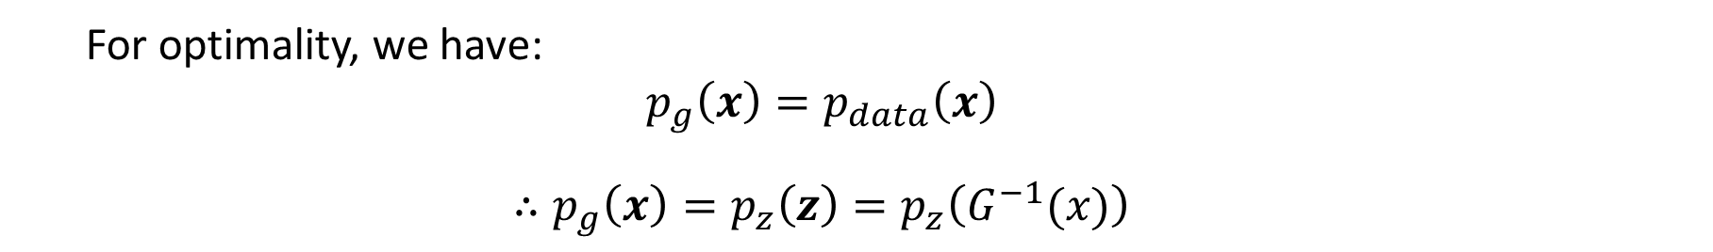
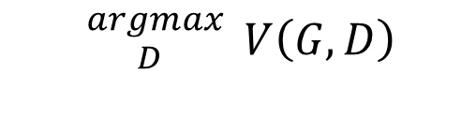
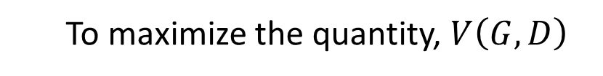
Understanding Objective Functions of GANs (Contd.)
For optimality, we have:
$$p_{g}\left(x\right)=p_{data}\left(x\right)$$
$$∴p_{g}\left(x\right)=p_{z}\left(z\right)=p_{z}\left(G^{−1}(x)\right)$$
$$∴V\left(G,D\right)=\int_{x}{p_{data}\left(x\right)\log{(D(x))}dx}+ \int_{x}{p_{z}\left(G^{−1}(x)\right)\log{(1−D(x))}G^{−1}′\left(x\right)dx }$$
$$=\int_{x}{{(p}_{data}\left(x\right)\log{(D(x))}}+p_{g}\left(x\right)\log{(1−D\left(x\right))})dx$$
To maximize the quantity, $V\left(G,D\right)$
$${}_{D }^{argmax}{ V\left(G,D\right)}$$

Slide 35
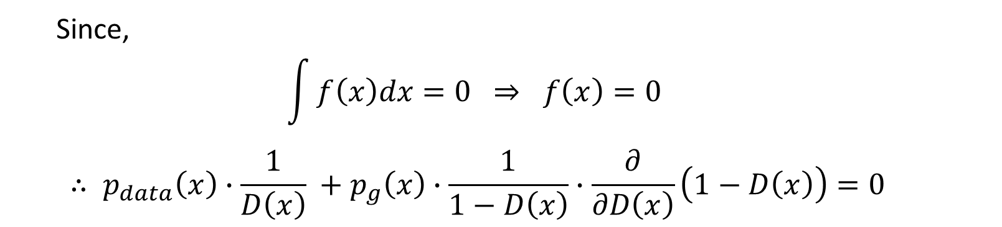
Understanding Objective Functions of GANs (Contd.)
${}_{D }^{argmax}{ V\left(D,G\right)}={}_{D }^{argmax}{\text{\{}\int_{x}{{(p}_{data}\left(x\right)\log{(D(x))}dx}+ p_{g}\left(x\right)\log{(1−D\left(x\right))})dx}$}
$$∴\frac{∂}{∂D(x)}[\int_{x}{{(p}_{data}\left(x\right)\log\left(D\left(x\right)\right)dx}+p_{g}\left(x\right)\log\left(1−D\left(x\right)\right))dx]=0$$
Since,
$$\int{f\left(x\right)dx}=0 ⇒ f\left(x\right)=0$$
$$∴ p_{data}\left(x\right)∙\frac{1}{D\left(x\right)} +p_{g}\left(x\right)∙\frac{1}{1−D\left(x\right)}∙\frac{∂}{∂D\left(x\right)}\left(1−D\left(x\right)\right)=0$$

Slide 36

Understanding Objective Functions of GANs (Contd.)
$$∴ p_{data}\left(x\right)∙\frac{1}{D\left(x\right)} −p_{g}\left(x\right)∙\frac{1}{1−D\left(x\right)}=0$$
$$∴ p_{data}\left(x\right) −D^{∗}(x)p_{data}\left(x\right)−p_{g}\left(x\right)D^{∗}(x)=0$$
$${D^{∗}}_{G}\left(x\right)=\frac{p_{data}(x)}{p_{data}\left(x\right)+p_{g}(x)}$$

Slide 37
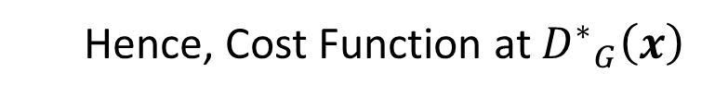
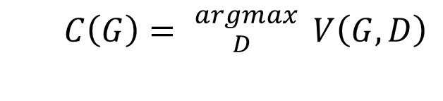
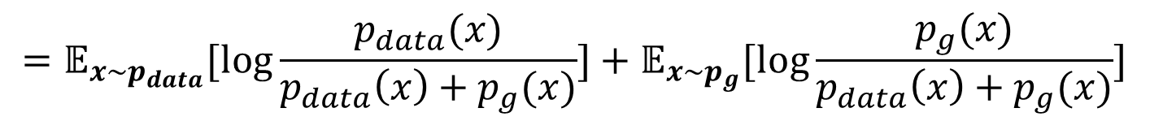
Understanding Objective Functions of GANs (Contd.)
Hence, Cost Function at ${D^{∗}}_{G}\left(x\right)$
$$C\left(G\right)= {}_{D }^{argmax}{ V\left(G,D\right)}$$
$$=𝔼_{x\sim p_{data}}[\log{{D^{∗}}_{G}(x)]}+𝔼_{z\sim p_{z}}[\log{(1−{D^{∗}}_{G}(G\left(z\right)))]}$$
$$=𝔼_{x\sim p_{data}}[\log{{D^{∗}}_{G}(x)]}+𝔼_{x\sim p_{g}}[\log{(1−{D^{∗}}_{G}(x))]}$$
$$=𝔼_{x\sim p_{data}}[\log{\frac{p_{data}(x)}{p_{data}\left(x\right)+p_{g}(x)}]}+𝔼_{x\sim p_{g}}[\log{\frac{p_{g}(x)}{p_{data}\left(x\right)+p_{g}(x)}]}$$

Slide 38
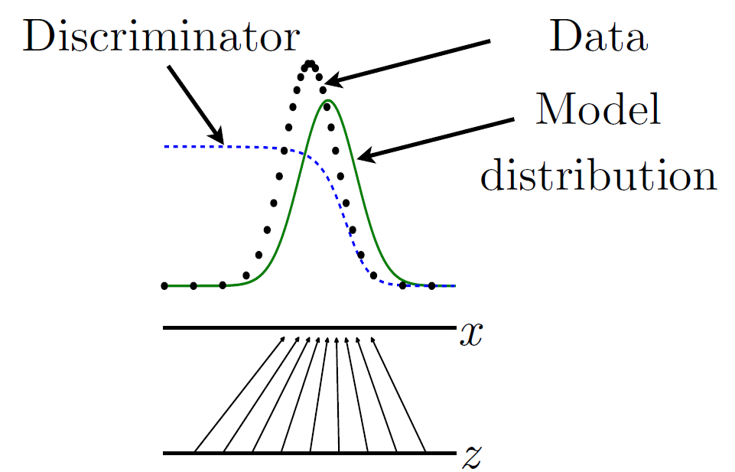
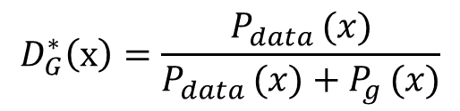


Training of GANs
When the output of discriminator is $D(x)$ is large, the model density is too low !
When the output of discriminator$D(x)$ is small, the model density is too high!
Figure: Illustrations of how discriminator estimates ratio of densities, i.e.,
$$D_{G}^{∗}\left(x\right)=\frac{P_{data }(x)}{P_{data }(x)+P_{g }(x)}$$
Source
Ian J. Goodfellow, “Tutorial: Generative adversarial networks”, In Advances in Neural Information Processing Systems, 2016.

Slide 39

Training of GANs (Contd.)
Figure: Intuitive Explanation of Training Procedure
Source
Ian J. Goodfellow, Pouget-Abadie, Mehdi Mirza, Bing Xu, David Warde-Farley, Sherjil Ozair, Aaron Courville, and Yoshua Bengio. "Generative Adversarial nets." In Advances in Neural Information Processing Systems, pp. 2672-2680. 2014

Slide 40

Training Algorithm of GANs (Contd.)
Source
Ian J. Goodfellow, Pouget-Abadie, Mehdi Mirza, Bing Xu, David Warde-Farley, Sherjil Ozair, Aaron Courville, and Yoshua Bengio. "Generative Adversarial nets." In Advances in Neural Information Processing Systems, pp. 2672-2680. 2014

Slide 41


Training (Contd.)
Stochastic gradient of the discriminator :
$$∇_{θ_{d}}\frac{1}{m}\sum_{i=1}^{m}{[\log{D\left(x^{(i)}\right)+log⁡(1−D(G\left(z^{(i)}\right)))}]}$$
$$⇒ ∇_{θ_{d}} log \prod_{i=1}^{m}{{D(x^{i})}^{\frac{1}{m}}∙{[1−D(G(z^{(i)}))]}^{\frac{1}{m}}}$$
$⇒ {D(x^{i})}^{\frac{1}{m}}$ and ${[1−D(G(z^{(i)}))]}^{\frac{1}{m}} ⇒$GANs form a probabilistic structure !
Similarly, stochastic gradient of the generator:
$$∇_{θ_{g}}\frac{1}{m}\sum_{i=1}^{m}{log⁡(1−D(G\left(z^{(i)}\right)))}⇒∇_{θ_{g}} log{\{\prod_{i=1}^{m}{\{1−D\left(G\left(z^{\left(i\right)}\right)\right)}\}}$$

Slide 42


Global Minimum of Optimization (Contd.)
Theorem 1: The global minimum of the virtual training criterion C(G) is achieved if and only if $P_{g}=P_{data, }$
At that point, C(G) achieves the value − log (4).
Proof: the optimal discriminator is given as,
$${D^{∗}}_{G}\left(x\right)=\frac{p_{data}(x)}{p_{data}\left(x\right)+p_{g}(x)}$$
We know,
$$C\left(G\right)={argmax}_{D}V\left(G,D\right)=V(G,{D^{∗}}_{G})$$
$$={argmax}_{D}\int_{x}{{(p}_{data}\left(x\right)\log{(D(x))}dx}+p_{g}\left(x\right)\log{(1−D\left(x\right))})dx$$
$$=\int_{x}{{(p}_{data}\left(x\right)\log{({D^{∗}}_{G}(x))}dx}+p_{g}\left(x\right)\log{(1−{D^{∗}}_{G}\left(x\right))})dx$$
$$=\int_{x}{{(p}_{data}\left(x\right)\log{(\frac{p_{data}(x)}{p_{data}\left(x\right)+p_{g}(x)})}dx}+p_{g}\left(x\right)\log{(1−\frac{p_{data}(x)}{p_{data}\left(x\right)+p_{g}(x)})})dx$$
$$=\int_{x}{{(p}_{data}\left(x\right)\log{\frac{\frac{p_{data}(x)}{p_{data}\left(x\right)+p_{g}(x)}}{2}}dx}+p_{g}\left(x\right)\log{(1−\frac{\frac{p_{data}(x)}{p_{data}\left(x\right)+p_{g}(x)}}{2})})dx−log⁡(4)$$

Slide 43






Global Minimum of Optimization (Contd.)
$$C\left(G\right)=KL \left[p_{data}\left(x\right)\right|| \frac{p_{data}\left(x\right)+p_{g}\left(x\right)}{2}]+KL [p_{g}\left(x\right)||\frac{p_{data}\left(x\right)+p_{g}\left(x\right)}{2}]−\log{4}$$
where KL is the Kullback-Leibler divergence.
Thus, when $p_{data}\left(x\right)=p_{g}\left(x\right)$, we get
$$C\left(G\right)=KL \left[p_{data}\left(x\right)\right||1]+KL [p_{g}\left(x\right)||1]−\log{4}$$
$$=\int_{x}{{(p}_{data}\left(x\right)\log{\frac{p_{data}\left(x\right)}{\frac{p_{data}\left(x\right)+p_{g}\left(x\right)}{2}}}dx}+p_{g}\left(x\right)\log{(\frac{p_{g}\left(x\right)}{\frac{p_{data}\left(x\right)+p_{g}\left(x\right)}{2}})})dx−log⁡(4)$$
$$=\int_{x}{{(p}_{data}\left(x\right)\log{(1)}dx}+p_{g}\left(x\right)\log{(1)})dx−log⁡(4)$$
$$=−log{(4)}$$
$$∵p_{data}\left(x\right)=p_{g}\left(x\right)$$
Source
Ian J. Goodfellow, Pouget-Abadie, Mehdi Mirza, Bing Xu, David Warde-Farley, Sherjil Ozair, Aaron Courville, and Yoshua Bengio. "Generative Adversarial nets." In Advances in Neural Information Processing Systems, pp. 2672-2680. 2014

Slide 44


Global Minimum of Optimization (Contd.)
We recognize in the previous expression the Jensen– Shannon Divergence (JSD) between the model’s distribution and the data generating process:
$C\left(G\right)=−log⁡(4+2.JSD(P_{data }||P_{g }))$.
Since the JSD between two distributions is always non-negative and zero only when they are equal, we have shown that $C^{∗}=−log⁡(4)$is the global minimum of C(G) and that the only solution is $P_{g }$ = $P_{data }$, i.e., the generative model perfectly replicating the data generating process
Source
Ian J. Goodfellow, Pouget-Abadie, Mehdi Mirza, Bing Xu, David Warde-Farley, Sherjil Ozair, Aaron Courville, and Yoshua Bengio. "Generative Adversarial nets." In Advances in Neural Information Processing Systems, pp. 2672-2680. 2014

Slide 45



Convergence:
Proposition 2. If G and D have enough capacity, and at each step of Algorithm 1, the discriminator is allowed to reach its optimum given G, and $P_{g }$ is updated so as to improve the criterion
$E_{x\sim P_{data}}[logD_{G}^{∗}\left(x\right)]$+$E_{x\sim P_{g}}\left[log⁡(1−D_{G}^{∗}\left(x\right)])\right]$
then $P_{g}$ converges to $P_{data}$
Proof:
Consider V (G, D) = U($P_{g}$, D) as a function of $P_{g}$ as done in the above criterion. Note that U($P_{g}$, D) is convex in $P_{g}$.
Why Convexity?
Guarantee for existence & uniqueness of optimum point.
Source
Kreyszig, Erwin. Introductory functional analysis with applications. Vol. 1. New York: Wiley, 1978.

Slide 46
GAN Architectures
Deep Convolutional GAN (DCGAN)
Laplacian GAN (LAPGAN)
Wasserstein GAN (WGAN)
Discover GAN (DiscoGAN)
Star GAN
Inception GAN
Source: Antonia Creswell, Tom White, Vincent Dumoulin, Kai Arulkumaran, Biswa Sengupta, and Anil A. Bharath. "Generative adversarial networks: An overview." IEEE Signal Processing Magazine, vol. 35, no. 1, pp: 53-65, Jan. 2018.
Original Source for Inception Networks :
C. Szegedy, W. Liu, Y. Jia, P. Sermanet, S. Reed, D. Anguelov, D. Erhan, V. Vanhoucke, and A. Rabinovich, “Going deeper with convolutions,” In Proceedings of the IEEE Conference on Computer Vision and Pattern Recognition,
pages 1–9, 2015.

Slide 47
Laplacian Pyramid of Adversarial Network (LAP-GAN)
Figure : The Sampling Procedure for LAPGAN Model.
Source:
P. J. Burt, Edward, and E. H. Adelson. The Laplacian pyramid as a compact image code. IEEE Transactions on Communications, 31:532–540, 1983.
E. L. Denton, S. Chintala, A. Szlam and R. Fergus, “Deep generative image models using a￼ laplacian pyramid of
adversarial networks,” In Advances in Neural Information Processing Systems, pp. 1486-1494.

Slide 48


Laplacian Pyramid: Birth to Wavelet and MRA !
Source:
https://en.wikipedia.org/wiki/Pyramid_(image_processing)
https://www.google.com/search?q=Wavelet+decomposition+of+Lena+Image,+Pyramid&rlz=1C1CHBF_enIN848IN848&tbm=isch&source=iu&ictx=1&fir=7awLxhurrURRhM%253A%252CQe13w_iWuRd2rM%252C_&vet=1&usg=AI4_kT34m1SoIqqTv_WmIE0Fa84y7szKQ&sa=X&ved=2ahUKEwjnlL3Z9MPiAhVGCqYKHU3CDOkQ9QEwAXoECAkQBg#imgrc=uXmcn247-EaymM:&vet=1
RM Rao, Ajit S. Bopardikar , “Wavelet transforms: Introduction to Theory and Applications,Prentice-Hall, 1998.
Stephane G. Mallat, “A Wavelet Tour of Signal Processing”, Academic Press, 2nd Edition, 1999.

Slide 49
















Signal Processing: FT-> fixed basis
GANs -> Basis learned from data
Coefficient space
Latent space
$|F(ω$)|
Amplitude
Time
$$ω$$
$$\hat{f}(t)$$
With every iteration $\hat{f}\left(t\right)$improves
True Signal
Fourier Transform
Analogy
$$F\left(ω\right)=ℱ\left\{f\left(t\right)\right\}=\int_{−∞}^{∞}{f(t)e^{−jωt}ⅆt}$$
$$ℱ(.)$$
Inverse Fourier Transform
$$f\left(t\right)$$
$$X$$
$$\hat{f}(t) =ℱ^{−1}\left\{f\left(t\right)\right\}=\frac{1}{2π}\int_{−∞}^{∞}{F(ω)e^{jωt}ⅆω}$$
$$F(ω)$$
$$z$$
$$\hat{f}(t)$$
G(z)
Reconstructed Signal
$ℱ^{−1}$(.)
Adversarial Training
Source
Antonia Creswell, Tom White, Vincent Dumoulin, Kai Arulkumaran, Biswa Sengupta, and Anil A. Bharath. "Generative adversarial networks: An overview." IEEE Signal Processing Magazine, vol. 35, no. 1, 2018, pp: 53-65.

Slide 50

Domain Mismatch in Speaker Recognition
Cross-lingual (CL) Speaker ID
Observations
Cross-lingual mode degrades SR performance severely
Testing language is very important for CL mode
Similar observation in Whispered Speech Recognition !
Source:
Hemant A. Patil, Speaker Recognition in Indian Languages: A Feature-Based Approach. PhD Thesis. Department of EE,
IIT Kharagpur , 2005.

Slide 51


Similar finding in cross-lingual speaker recognition, NIST SRE, USA
Note: There has been a growing interest in designing ASR systems for bilingual speakers (e.g. speakers who are fluent in English and any one of the Arabic, Mandarin, Spanish, etc.).
Source:
M. A. Prybocki, A. F. Martin and A. N. Le, “NIST Speaker Recognition Evaluations Utilizing the Mixer Corpora-2004, 2005, 2006,” IEEE Trans. Audio, Speech, and Language Proc., vol. 15, No. 7, Sept. 2007.

Slide 52
GANs for Domain Adaptation
NIST SRE 2016 -> Designed for CL SR
Key Idea: Confuse a domain discriminator for embeddings from source or target domains !
GAN models improve ASV by 7.2 % over baseline
Source:
Gautam Bhattacharya, Joao Monteiro, Jahangir Alam, Patrick Kenny, “GENERATIVE ADVERSARIAL SPEAKER EMBEDDING NETWORKS FOR DOMAINROBUST END-TO-END SPEAKER VERIFICATION ,” ICASSP 2019, Brighton, UK, pp. 6226-6230, 2019.

Slide 53



GANs for Domain Adaptation (contd.)
Source:
Gautam Bhattacharya, Joao Monteiro, Jahangir Alam, Patrick Kenny, “GENERATIVE ADVERSARIAL SPEAKER EMBEDDING NETWORKS FOR DOMAINROBUST END-TO-END SPEAKER VERIFICATION ,” ICASSP 2019, Brighton, UK, pp. 6226-6230, 2019.

Slide 54
GANs for other Speech Technology Applications
NAM-to-Whisper
Whisper-to-Speech
Voice Conversion
Speech Enhancement

Slide 55


Non-Audible Murmur (NAM) Microphone
1. NAM is body conductive microphone one of the silent speech interface techniques.
2. Detects quiet speech NAM that even listeners around the speaker can hardly hear.
3. Position to place NAM microphone is just behind the ear.
Figure: Schematic representation of NAM microphone [1]
Source: Available Online from Nara Institute of Science and Technology, Japan

Slide 56
Non-Audible Murmur (NAM) Microphone
Key issue:
1. suffers from the speech quality degradation.
lack of radiation effect at the lips and lowpass nature of the soft tissue, which attenuates the high frequency related
information.
Applications:
NAM can detect whisper or unvoiced speech.
NAM can be used to talk in noisy environment without talking a loud.
NAM can be useful to detect speech from the patients who are suffering from vocal folds related diseases.
Source
Neil Shah, Nirmesh J. Shah, and Hemant A. Patil, "Effectiveness of Generative Adversarial Network for Non-Audible Murmur-to-Whisper Speech Conversion", in INTERSPEECH, Hyderabad, India, 2018, pp. 3157-3161

Slide 57

Non-Audible Murmur (NAM) Microphone
Figure: Proposed schematic representation of the GAN-based NAM2WHSP conversion system.
Source
Neil Shah, Nirmesh J. Shah, and Hemant A. Patil, "Effectiveness of Generative Adversarial Network for Non-Audible Murmur-to-Whisper Speech Conversion", in INTERSPEECH, Hyderabad, India, 2018, pp. 3157-3161.

Slide 58

Non-Audible Murmur (NAM) Microphone
Figure: MCD and PESQ analysis of different NAM2WHSP systems, Panel I: symmetric context and Panel II: asymmetric context.
There is clear improvement in the PESQ with the increase in the contextual region.
Asymmetric contextual helps to get better MCD in the GAN-based system.
Source
Neil Shah, Nirmesh J. Shah, and Hemant A. Patil, "Effectiveness of Generative Adversarial Network for Non-Audible Murmur-to-Whisper Speech Conversion", in INTERSPEECH, Hyderabad, India, 2018, pp. 3157-3161

Slide 59

Non-Audible Murmur (NAM) Microphone
Figure: (a) MCD and (b) PESQ analysis of the various developed NAM2WHSP systems w.r.t. the amount of available training data.
GAN outperforms DNN both interms of MCD and PESQ with the increase amount of training data.
Source
Neil Shah, Nirmesh J. Shah, and Hemant A. Patil, "Effectiveness of Generative Adversarial Network for Non-Audible Murmur-to-Whisper Speech Conversion", in INTERSPEECH, Hyderabad, India, 2018, pp. 3157-3161

Slide 60
Whisper-To-Normal Speech Conversion
Proposed: MMSE DiscoGAN: Whisper-to-Speech (WHSP2SPCH) Conversion.
Cross-Domain Whispered and normal Speech
Speech production-perception perspective
Absence of vocal folds vibrations in whispered speech.
Whispered speech is completely aperiodic or unvoiced.
Differences in : Phone duration, energy distribution across phone classes etc.
Cortical hemodynamic response was more profound for the whispered speech.

Slide 61

Whisper-To-Normal Speech Conversion (Contd.)
Figure: Proposed architecture of MMSE DiscoGAN. Here, W: Whisper and S: Speech.
Two generators, one for whisper-to-normal speech, and normal-to-whispered speech.
Mapping the converted speech again to the whispered speech enforces converted features to be more natural.
Source
Nirmesh J. Shah, Mihir Parmar, Neil Shah and Hemant A. Patil, "Novel MMSE DiscoGAN for Cross-Domain Whisper-to-Speech Conversion", in Machine Learning in Speech and Language Processing (MLSLP) Workshop, Google Office, Hyderabad, September 7, 2018, pp. 1-3.
T. Kim, M. Cha, H. Kim, J. K. Lee, and J. Kim, “Learning to discover cross-domain relations with generative adversarial networks,” in International conference on Machine Learning (ICML), Sydney, Australia, 2017, pp.1857-1865.

Slide 62


Whisper-To-Normal Speech Conversion (Contd.)
Figure: (a) $log⁡(F_{0})$ predicted using the proposed DiscoGAN-based system, and (b) corresponding $log⁡(F_{0})$of natural speech signal.
Table: RMSE-based objective analysis of $log⁡(F_{0})$. Here, numbers in the bracket indicates the % relative reduction in the RMSE w.r.t. the baseline.
Source
Nirmesh J. Shah, Mihir Parmar, Neil Shah and Hemant A. Patil, "Novel MMSE DiscoGAN for Cross-Domain Whisper-to-Speech Conversion", in Machine Learning in Speech and Language Processing (MLSLP) Workshop, Google Office, Hyderabad, September 7, 2018, pp. 1-3.

Slide 63

Subjective Evaluation
Whisper-To-Normal Speech Conversion (Contd.)
20 subjects (17 males and 3 females with no known hearing impairments) participate in test.
Table: % Preference Score (PS) for the Baseline vs. MMSE-GAN, and the Baseline vs. MMSE DiscoGAN.
Proposed MMSE-GAN, and MMSE-DiscoGAN architectures are performing better than the baseline DNN.
Source
Nirmesh J. Shah, Mihir Parmar, Neil Shah and Hemant A. Patil, "Novel MMSE DiscoGAN for Cross-Domain Whisper-to-Speech Conversion", in Machine Learning in Speech and Language Processing (MLSLP) Workshop, Google Office, Hyderabad, September 7, 2018, pp. 1-3.

Slide 64

Time-Frequency masking using GANs
Initially
Adversarial training
Easily identifies the generator produced spectrum as fake
Noisy spectrum
G
Fake spectrum
D
Clean spectrum
After few epochs
Gets confused between generator produced spectrum and clean spectrum
Adversarial training
Noisy spectrum
G
Enhanced
spectrum
D
Clean spectrum
Initially G fools the D, but with certain epochs the D tries not to get fooled by the G.
This forces the G network to optimize the parameters accordingly and to move towards producing clean spectrum.
Once D is not able to discriminate, $P\left(Enhanced spectrum\right)=P\left(Clean spectrum\right)=\frac{1}{2}$.
Thus the fake spectrum can be considered as an enhanced spectrum that matches closely with the clean spectrum.

Slide 65
Time-Frequency masking using Vanilla GANs
Vanilla GAN (v-GAN) has the same architecture as discussed earlier.
v-GAN enhances the noisy mixture at the input by inherently estimating the mask.
The G network generates the enhanced spectrum and the D network acts a a binary classifier in differentiating between the clean and enhanced spectrum.
This method generalizes well to the different feature space.
Source:
Meet H. Soni, Neil Shah, and Hemant A. Patil, ”Time-Frequency masking-based speech enhancement using Generative Adversarial Network”, in IEEE International Conference on Acoustics, Speech, and Signal Processing (ICASSP), Calgary, Alberta, Canada, 2018, pp. 5039–5043.

Slide 66
Time-Frequency masking using Vanilla GANs: Results
Figure: v-GAN fails to properly predict the mask (a) Clean T-F representation: the solid-circle region shows the silence frame, (b) enhanced T-F representation: the dotted-circle shows the predicted frame where GAN fails, (c) noisy T-F representation and (d) predicted mask.
Source:
Meet H. Soni, Neil Shah, and Hemant A. Patil, ”Time-Frequency masking-based speech enhancement using Generative Adversarial Network”, in IEEE International Conference on Acoustics, Speech, and Signal Processing (ICASSP), Calgary, Alberta, Canada, 2018, pp. 5039–5043.

Slide 67
Time-Frequency masking using Vanilla GANs: Observations
The dotted circle in the Fig. (b) shows the area where GAN is not able to predict the mask accurately.
2. However, the enhanced spectrum of the region resembles the region of the clean spectrum in Fig. (a) showed by
the solid circle.
The output of G is not accurate for the given frame, while it still belongs to the distribution of clean spectrum.
4. Hence, the D is not able to differentiate it as fake representation and learning fails. The cost of D is also
observed to be low at such instances.
Source:
Meet H. Soni, Neil Shah, and Hemant A. Patil, ”Time-Frequency masking-based speech enhancement using Generative Adversarial Network”, in IEEE International Conference on Acoustics, Speech, and Signal Processing (ICASSP), Calgary, Alberta, Canada, 2018, pp. 5039–5043.

Slide 68

Time-Frequency masking using MMSE-GAN
Problem: The G network fool’s the D network, by producing enhanced representation of some other frame.
Solution: Regularize the G network’s objective function, by minimizing the Minimum Mean Square Error (MMSE) between the enhanced and the corresponding clean spectrum.
The D network’s objective function remains the same.
Thus the modified G network’s objective function is
This extra term in the G network’s objective function calculates the MMSE between the enhanced spectrum generated by the G network and the corresponding clean spectrum.
$$\min_{G}{V(G)}=−𝔼_{y\sim 𝒴 }\left[\log{D\left(G\left(y\right)\right)}\right]+\frac{1}{2}𝔼_{x\sim 𝒳,y\sim 𝒴 }\left[\log{x}−\log{G\left(y\right)}\right]……….(3)$$
$$\min_{D}{V(D)}=−𝔼_{x\sim 𝒳}\left[\log{D(x)}\right]−𝔼_{y\sim 𝒴 }\left[1−\log{D\left(G\left(y\right)\right)}\right] …………\left(4\right)$$
Source:
Meet H. Soni, Neil Shah, and Hemant A. Patil, ”Time-Frequency masking-based speech enhancement using Generative Adversarial Network”, in IEEE International Conference on Acoustics, Speech, and Signal Processing (ICASSP), Calgary, Alberta, Canada, 2018, pp. 5039–5043.

Slide 69
Network parameters for DNN, v-GAN, and MMSE-GAN
Network are compared:
DNN
v-GAN
MMSE-GAN
Model | Input | 3-Hidden layers | Output
DNN | 448 | 512 | 64
G-network in GAN | 448 | 512 | 64
D-network in GAN | 64 | 512 | 1
64-channel Gammatone filterbank with 20 ms Hamming window length and 10 ms window shift, and 7 frame context.
Adam optimizer with learning rate 0.001 and batch size of 1000.
Source:
Meet H. Soni, Neil Shah, and Hemant A. Patil, ”Time-Frequency masking-based speech enhancement using Generative Adversarial Network”, in IEEE International Conference on Acoustics, Speech, and Signal Processing (ICASSP), Calgary, Alberta, Canada, 2018, pp. 5039–5043.

Slide 70
Time-Frequency masking: Database
The database released by Valentini et. Al. is used for simulating the algorithm.
The training and testing set have mismatched conditions.
The noisy training set is prepared with a total 0f 40 different noisy conditions with 10 types of noise and 4 signal-to-noise ratio (SNR) each (15, 10, 5, and 0 dB).
The noisy test set is prepared with a total 0f 20 different noisy conditions with 5 types of noise and 4 signal-to-noise ratio (SNR) each (17.5, 12.5, 7.5, and 2.5 dB).
The database comprises of 11572 training utterances and 824 testing utterances .
Source:
B. Valentini, Cassia, et al. ”Investigating RNN-based speech enhancement methods for noise-robust Text-to-Speech,” in 9th ISCA Speech Synthesis Workshop, Sep. 13-15, Sunnyvale, CA, USA, 2016. http://datashare.is.ed.ac.uk/handle/10283/1942/, [online; Last Accessed 25-July-2017].

Slide 71
Results of T-F masking using DNN, v-GAN, and MMSE-GAN architecture
Table: Performance comparisons between the noisy signal, DNN, v-GAN,
MMSE-GAN , SEGAN and the Wiener filter-based enhancement.
Metric | Noisy | DNN | v-GAN | MMSE-SEGAN | SEGAN | Wiener
CSIG | 3.35 | 3.73 | 2.48 | 3.80 | 3.48 | 3.23
CBAK | 2.44 | 3.09 | 2.64 | 3.12 | 2.94 | 2.68
CMOS | 2.63 | 3.09 | 1.91 | 3.14 | 2.8 | 2.67
PESQ | 1.97 | 2.49 | 1.41 | 2.53 | 2.16 | 2.22
STOI | 0.91 | 0.93 | 0.79 | 0.93 | 0.93 | -
MMSE-GAN simply modifies v-GAN objective function by adding a MMSE regularizer.
The MMSE-GAN architecture leads to improved performance over DNN, that are the state-of-the-art SE techniques.
Comparison with SEGAN (INTERSPEECH 2017) suggest that T-F masking-based approaches are better for SE task.
Source:
Meet H. Soni, Neil Shah, and Hemant A. Patil, ”Time-Frequency masking-based speech enhancement using Generative Adversarial Network”, in IEEE International Conference on Acoustics, Speech, and Signal Processing (ICASSP), Calgary, Alberta, Canada, 2018, pp. 5039–5043.

Slide 72
Research Frontiers (Open Research Problems)
Training Issues -> Non- Convergence
Mode Collapse
Evaluations of GANs
GANs as inverse reinforcement learning (RL).
Discrete Output -> Potential for GANs for NLP

Slide 73
Acknowledgements
Dr. Vikram Vij (Vice President, Voice Intelligence Group), Samsung R&D Institute, Bangalore.
Authorities of DA-IICT Gandhinagar
Authorities of SRI-B
Govt. of India Funding Bodies: MeitY, DST, UGC.
Speech Research Lab Members @ DA-IICT

Slide 74
Thank You !

